Slide 1
ACADEMIC PROTOTYPE
AI Forensic Investigation System
Natural-language investigation over CCTV and live cameras —
with evidence you can trace, not guesses you cannot.
Problem · Solution · Architecture · Working

Slide 2
Problem statement
Why this project exists
• Investigators still watch hours of CCTV by hand to answer a simple question.
• Clips, cameras, and timestamps sit in separate tools, so the story is easy to lose.
• Generic AI chat can invent people, times, or intent — that is not usable as evidence.
• Live cameras and uploaded footage are treated as two different worlds.
Need: an assistant that finds relevant footage in plain language, keeps original evidence immutable, never claims identity or invents timestamps, and leaves the final decision with a human reviewer.
AI Forensic Investigation System · academic prototype
2 / 7

Slide 3
Solution
What we built
A GenAI investigation assistant for security staff — not an autonomous security system.
Upload CCTV
Watch live
FFmpeg splits video into clips. YOLO detects objects. Tracks get IDs such as Person-001 — never a name or face ID.
Webcam, USB, RTSP, IP, phone (WebRTC), or demo file. Same pipeline: detect → track → optional VLM → evidence.
Ask in English
Review and report
Search clips and live evidence with a natural-language query, scoped to the cameras in the case.
A bounded agent proposes findings. A human approves or rejects. Then a forensic PDF is generated.
AI Forensic Investigation System · academic prototype
3 / 7

Slide 4
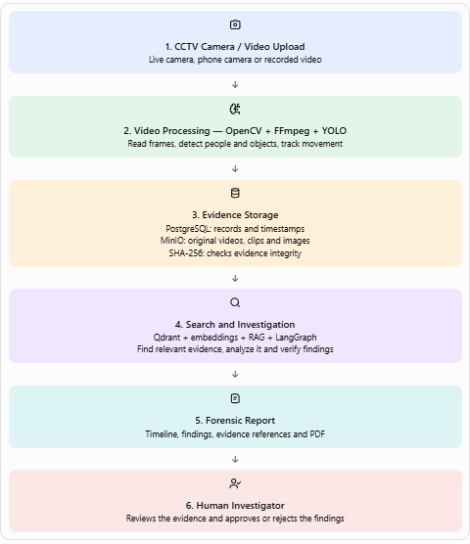
Architecture

Slide 5
Working — how footage becomes evidence
Two paths, one ledger
Path A · uploaded CCTV
Path B · live camera
1. Investigator uploads MP4/MOV (linked to a camera).
2. Original file is stored and treated as immutable.
3. FFmpeg reads metadata and extracts clips.
4. Scene detection cuts the video at real cuts.
5. YOLO draws boxes; tracker assigns Person-001 IDs.
6. Clips, detections, and events are saved.
7. Content is indexed so it can be searched later.
1. Start a session (one active session per camera).
2. Frames enter: ingest → sample → rolling buffer.
3. YOLO runs on sampled frames.
4. Tracker emits enter / leave / motion events.
5. VLM may describe selected frames (or skip).
6. A small JPEG is stored with SHA-256.
7. Postgres + MinIO + Qdrant are updated together.
AI Forensic Investigation System · academic prototype
5 / 7

Slide 6
Working — how an investigation runs
Ask → retrieve → review → report
1
Ask
2
Retrieve
3
Agent
Type a question, e.g. “person with a backpack near camera 2 after 18:00”.
RAG searches Qdrant, then filters by camera, time, and objects. Out-of-case cameras are excluded.
A capped LangGraph run: classify, plan, retrieve, analyze, verify. It stops if the budget is exceeded.
4
Review
5
Forensics
6
Report
If findings are reviewable, status is READY FOR REVIEW. A human approves, rejects, or cancels.
Only evidence the run already used is correlated into a timeline. Gaps and conflicts are listed, not hidden.
A PDF is written with claims, evidence IDs, and verification labels: Observed / Inferred / Unknown / Conflicting.
AI Forensic Investigation System · academic prototype
6 / 7

Slide 7
What the system will not do
Safety rules that shape the working
No face recognition
No names, biometrics, or identity claims. Only visual track IDs.
No invented time
Timestamps come from video metadata or the live clock — never from the model.
No fake AI results
If YOLO or the LLM is missing, the pipeline skips or answers UNKNOWN.
Human owns the close
The agent assists. A reviewer must approve before a forensic report is final.
AI Forensic Investigation System · academic prototype
7 / 7

